Slide 1

Bank loan of customers
DOMAIN : FINANCE

Slide 2





PROJECT TOOLS AND INSIGHTS INDEX
EXCEL
POWER BI
TABLEAU
MYSQL
ANALYTICS
DASHBOARD
DASHBOARD
DASHBOARD
QUERIES & OUTPUT
INSIGHTS &
CONCLUSION

Slide 3




Dashboards
Insights
KPI’s

Slide 4


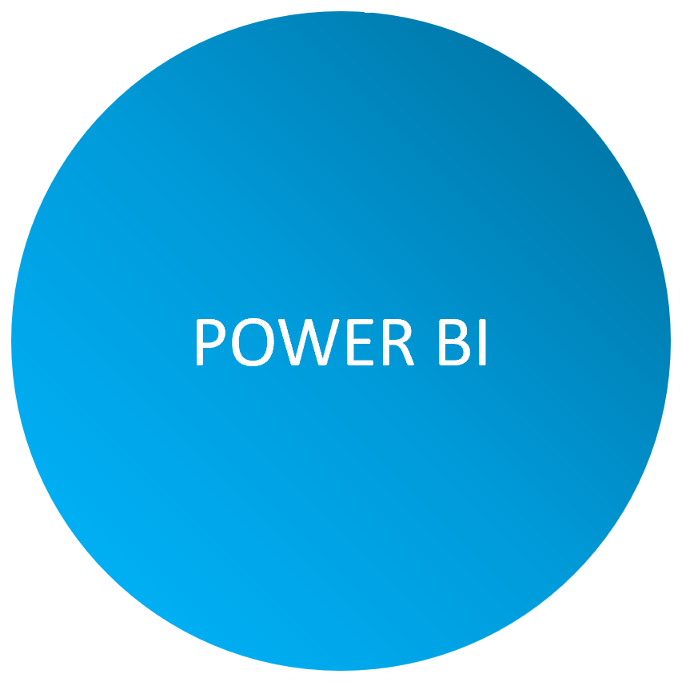


Dashboards

Slide 5
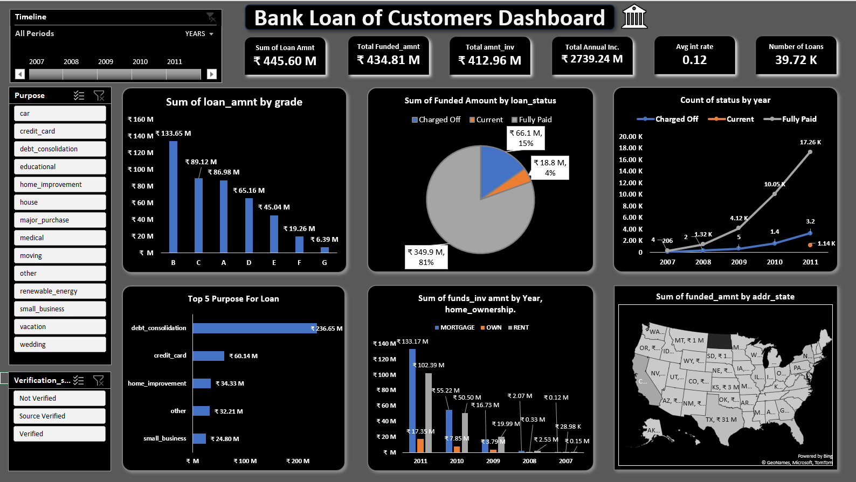
Excel dashboard

Slide 6

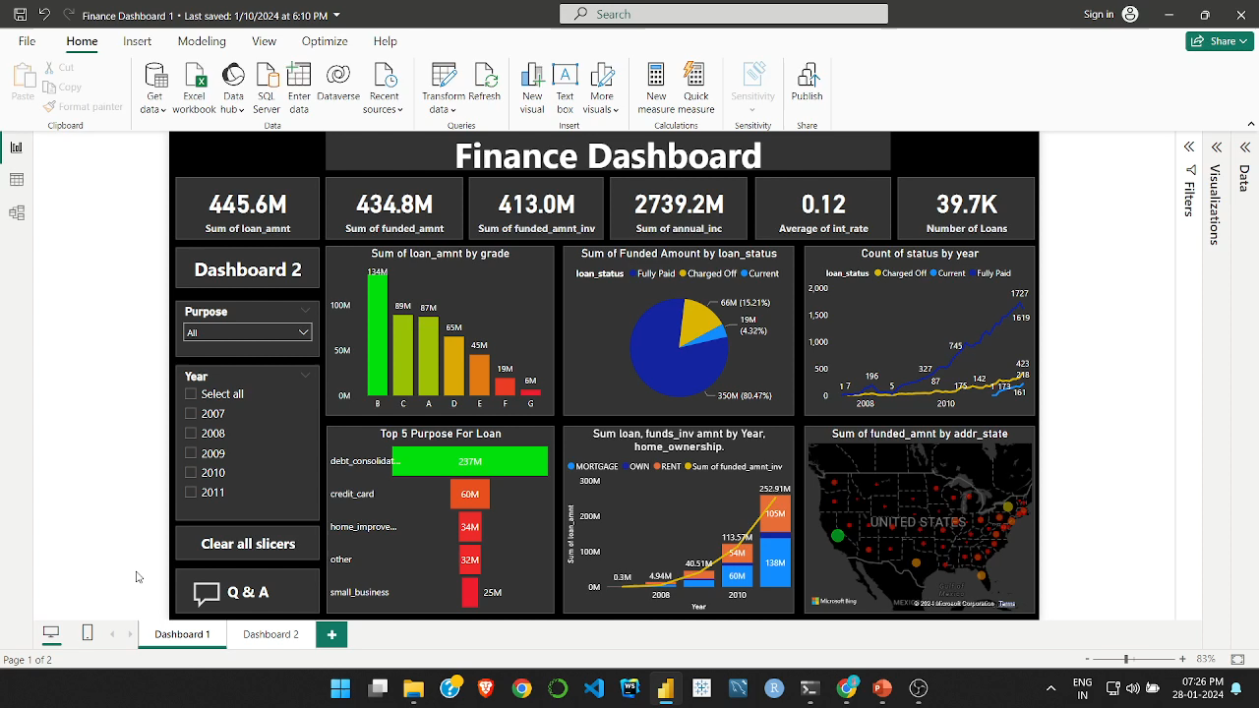
Power bi dashboard

Slide 7

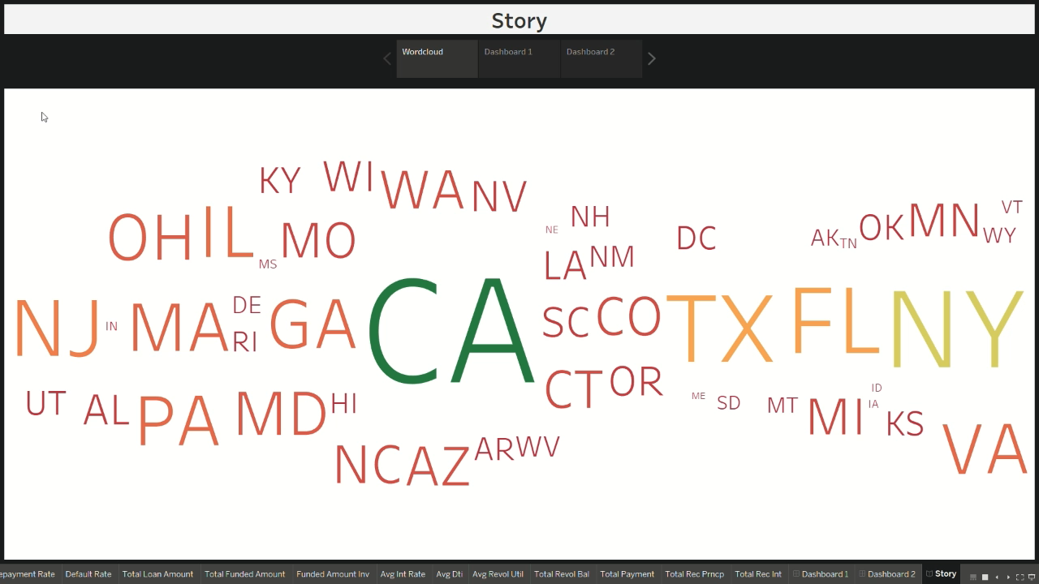
Tableau dashboard

Slide 8
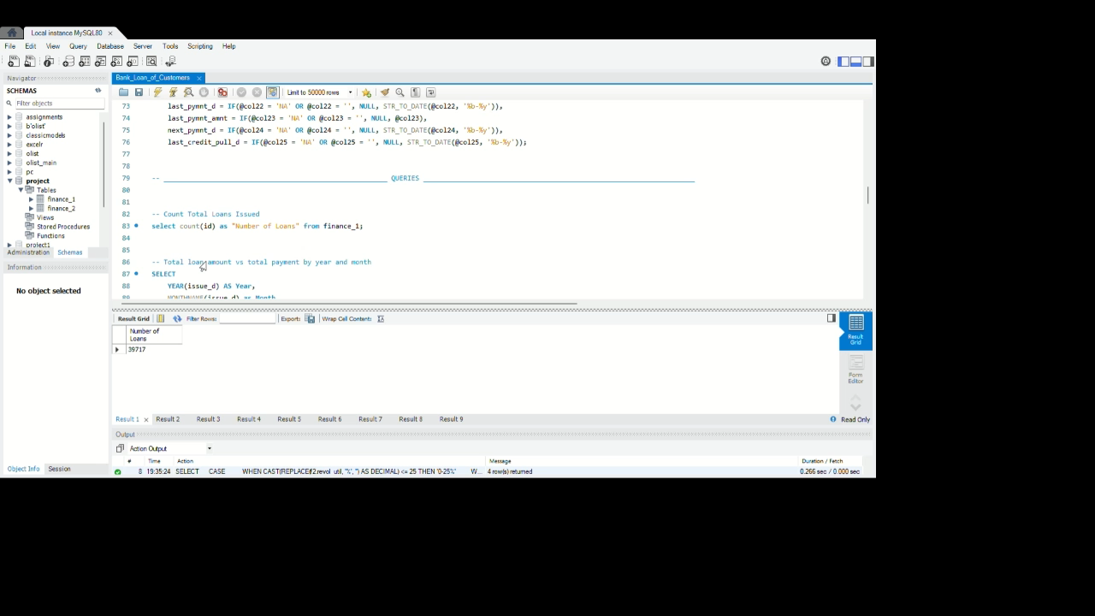
Mysql query & output

Slide 9
Kpi’s
Excel
Power bi
Tableau
MySQL
Sum of loan_amnt by grade
Sum of Funded Amount by loan_status
Count of status by year
Top 5 Purpose For Loan
Sum of funds_inv amnt by Year, home_ownership.
Sum of funded_amnt by addr_state
State wise loan information (Matrix)
Bar chart for every parameters
Repayment rate
Sum loan, funds_inv amnt by Year, home_ownership.
Default rate.
Funded Amount by Home_Ownership
Loan Amount by Grade
Loan & Total_Payment by Year
Funded Amnt & Total_Rec_Prncp by year
Top and Bottom 3 state by Total Payment
Funded_Amnt_Inv by Purpose
Count Total Loans Issued
Total loan amount vs total payment by year and month
Top 5 States with the Most Loans
Top Borrower States by Total Payments
Revolving Utilization Rate Distribution
Loans with Delinquency Issues

Slide 10


Slide 11
INSIGHTS
The bank has provided a total of 39.7k loans. The loan amount issued is increasing every year.
The average interest rate of the bank is 0.12%.
The bank has received an interest of 89.91M and a late fee of 54.13K.
loan status: Charged Off 5,627, Current 1,140, Fully Paid 32,950

Slide 12
INSIGHTS
Grade wise loan amount : Top - B with 134M Bottom – G with 6M
Purpose wise loan amount : Top 3 Debt consolidation, credit card and home improvement Least 3 : renewable energy, vacation and education
Address state wise top loan amount: CA- 46.3M, NY- 24M, TX- 18.7M

Slide 13
CONCLUSION
Overall, the bank's lending operations are robust, with a growing loan portfolio and significant interest revenue. The diversity in loan grades, purposes, and geographical distribution indicates a well-rounded lending strategy. However, the presence of charged-off loans suggests the importance of effective risk management and mitigation strategies to minimize losses. Additionally, the bank could further explore opportunities in states with high loan demand and potentially expand its offerings to cater to a wider range of purposes for which customers seek financing.

Slide 14
RECOMMENDATION
1.Strengthen lending standards and risk assessment processes.
2.Diversify loan portfolio across sectors/types for risk mitigation
3.Encourage responsible credit utilization to minimize revolving balances across all loan grades.
4.Provide education and resources to borrowers to promote responsible payment behavior across all verification statuses
5.Support resources for managing financial responsibilities of homeowners with outright ownership.

Slide 15
THANKYOU

